Slide 1


Artificial Intelligence
Unit-3
Artificial Intelligence
3170716
Department of Computer Engineering
Unit#1 Introduction to Data Structures

Slide 2
Unit-3 Knowledge Representation
In this unit you will be able to understand the following concepts:
Representations And Mappings, Approaches To Knowledge Representation,
Representation Simple Facts In Logic, Representing Instance And Isa
Relationships
Computable Functions and Predicates, Resolution, Procedural versus Declarative Knowledge, Logic Programming, Forward versus Backward Reasoning.

Slide 3
Knowledge
Knowledge is a general term.
knowing "how to do something".
e.g. "how to drive a car" is Procedural knowledge.
knowing "that something is true or false".
e.g. "that is the speed limit for a car on a motorway" is D e c l a r a t i v e K n o w l e d g e .
Different types of knowledge require different kinds of representation.
The Knowledge Representation models/mechanisms are often based on:
Logic
Frames
Rules
Semantic Net
Knowledge is a progression that starts with data which is of limited utility.
By organizing or analyzing the data, we understand what the data means,and this becomes
information.
The interpretation or evaluation of information yield knowledge.
An understanding of the principles embodied within the knowledge is wisdom.

Slide 4
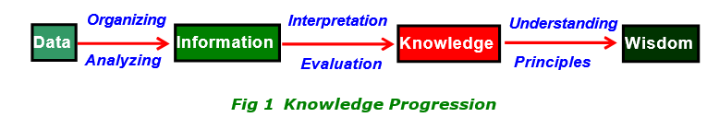
Knowledge Progression
Data is viewed as collection of
disconnected facts.
Information emerges when relationships among facts are established and understood; Provides answers to "who", "what", "where", and "when".
Knowledge emerges when relationships among patterns
are identified and understood;Provides answers as "how" .
: Example : It is raining.
: Example : The temperature dropped 15 degrees and then it started raining.
: Example : If the humidity is very high and the temperature drops substantially, then atmospheres is unlikely to hold the moisture, so it rains.
Wisdom is the pinnacle of understanding, uncovers the
principles of relationships thatdescribe patterns.
Provides answers as "why" .
: Example : Encompasses understanding of all the interactions that happen between raining, evaporation, air currents, temperature gradients,
changes, and raining.

Slide 5
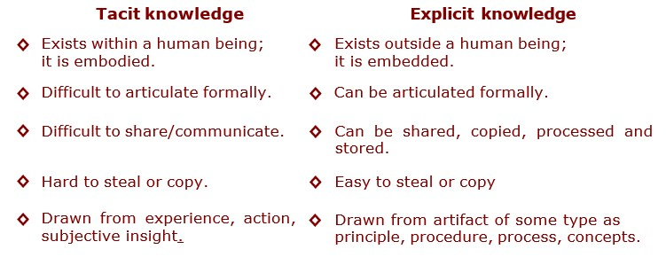
Knowledge Types
Knowledge is categorized into two major types: Tacit and Explicit.
term “Tacit” corresponds to informal or implicit type of knowledge,
term “Explicit” corresponds to formal type of knowledge.

Slide 6
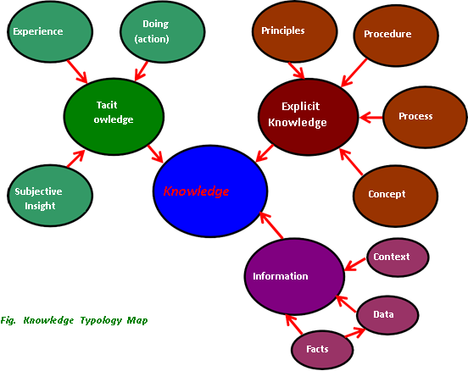
Knowledge typology map
The map shows that,
knowledge comes
Tacit
from
experience, action, subjective insight and Explicit knowledge comes from principle, procedure, process, concepts, via transcribed content or artifact of some type.

Slide 7
Knowledge typology map
Facts : are data or instance that are specific and unique.
Concepts : are class of items, words, or ideas that are known by acommon name and share common features.
Processes : are flow of events or activities that describe how things work rather than how to do things.
Procedures : are series of step-by-step actions and decisions that resultin the
achievement of a task.
Principles : are guidelines, rules, and parameters that govern; principles allow to make predictions and draw implications;
principles are the basic building blocks of theoretical models (theories).

Slide 8
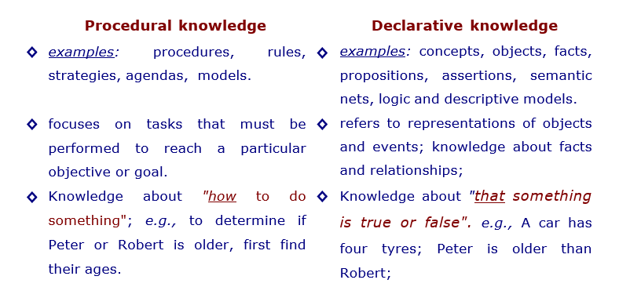
Declarative and Procedural Knowledge
Cognitive psychologists sort knowledge into Declarative and Procedural category and some researchers added Strategic as a third category.

Slide 9
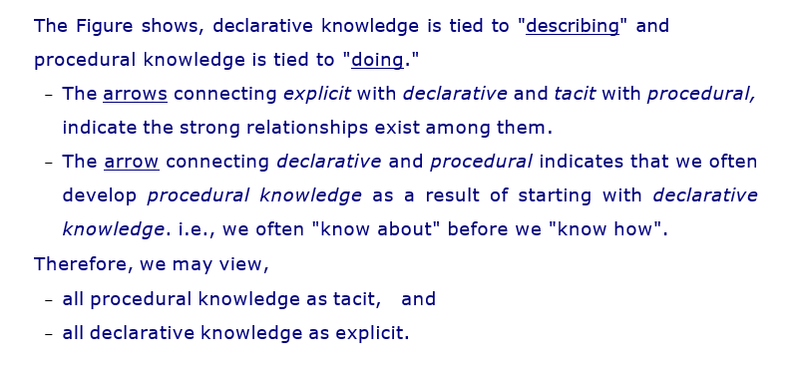
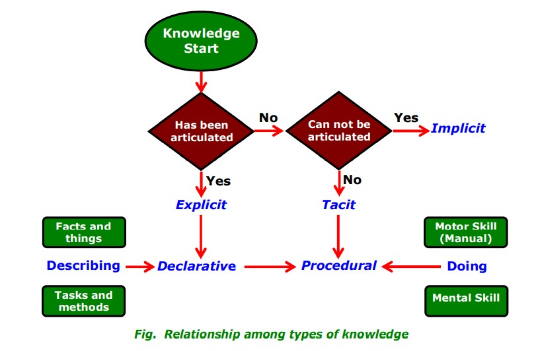
Relationship among knowledge type

Slide 10
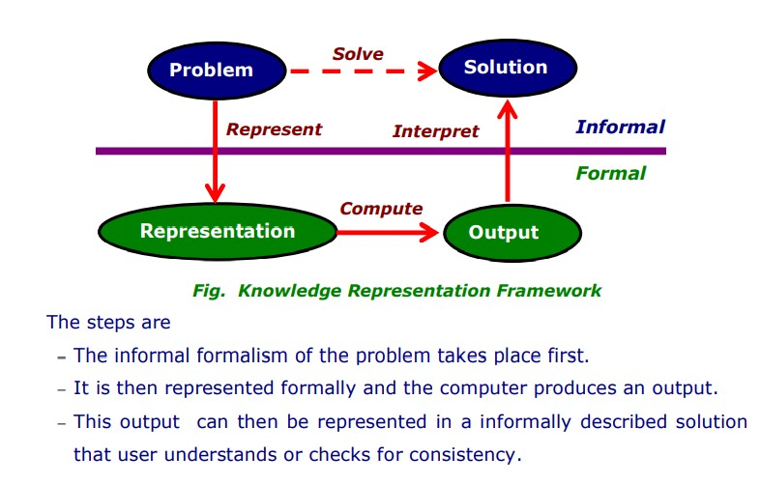
Framework of Knowledge representation
Computer requires a well- defined problem description to process and also provide well- defined acceptable solution. To collect fragments of knowledge we need : first to formulate description in our spoken language and then represent it in formal language so that computer can understand. The computer can then use an algorithm to compute an answer.

Slide 11
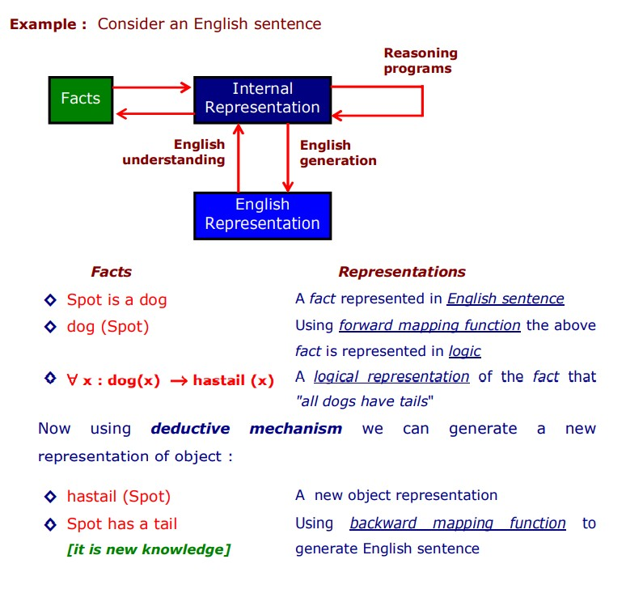
Mapping between Facts and Representation
Knowledge is a collection of “facts” from some domain. We need a representation of facts that can be manipulated by a program. Normal English is insufficient, too hard currently for a computer program to draw inferences in natural languages. Thus some symbolic representation is necessary. Therefore, we must be able to map "facts to symbols" and "symbols to facts" using forward and backward representation mapping.

Slide 12
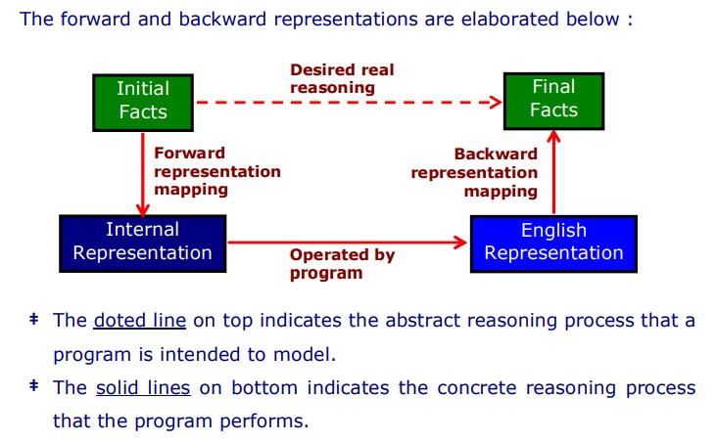
Forward and Backward representation

Slide 13
Knowledge Representation schemes
There are four types of Knowledge representation - Relational, Inheritable, Inferential, and Declarative/Procedural.
Relational Knowledge :
provides a framework to compare two objects based on equivalent attributes.
any instance in which two different objects are compared is a relational
type of knowledge.
Inheritable Knowledge
is obtained from associated objects.
it prescribes a structure in which new objects are created which may inherit all or a subset of attributes from existing objects.
Inferential Knowledge
is inferred from objects through relations among objects.
e.g., a word alone is a simple syntax, but with the help of other words in phrase the reader may infer more from a word; this inference within linguistic is called semantics.

Slide 14
Declarative Knowledge
a statement in which knowledge is specified, but the use to which that knowledge is to be put is not given.
e.g. laws, people's name; these are facts which can stand alone, not
dependent on other knowledge;
Procedural Knowledge
a representation in which the control information, to use the knowledge, is
embedded in the knowledge itself.
e.g. computer programs, directions, and recipes; these indicate specific
use or implementation;

Slide 15
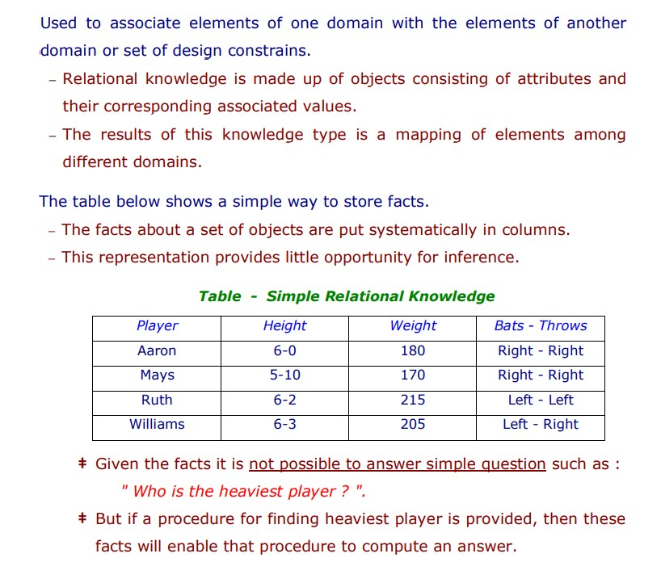
1.Relational Knowledge

Slide 16
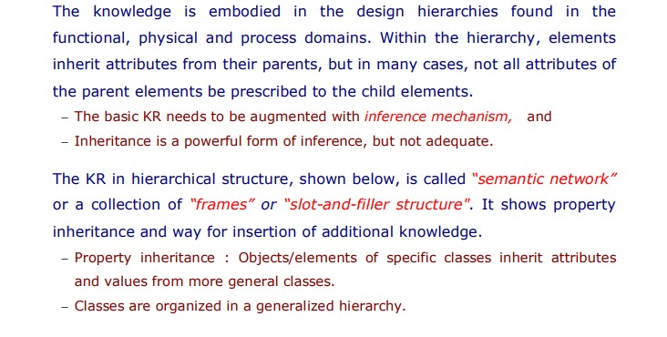
2.Inheritable knowledge :

Slide 17
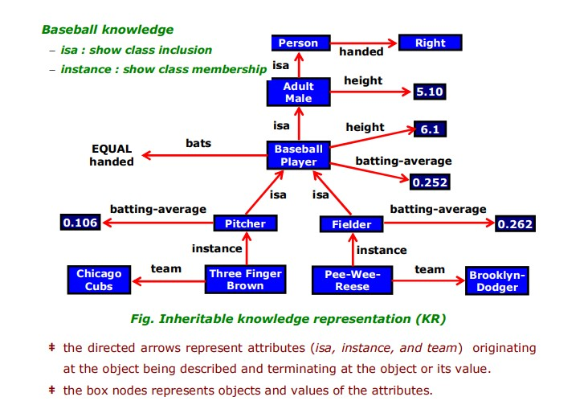

Slide 18
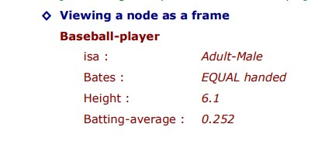

Slide 19
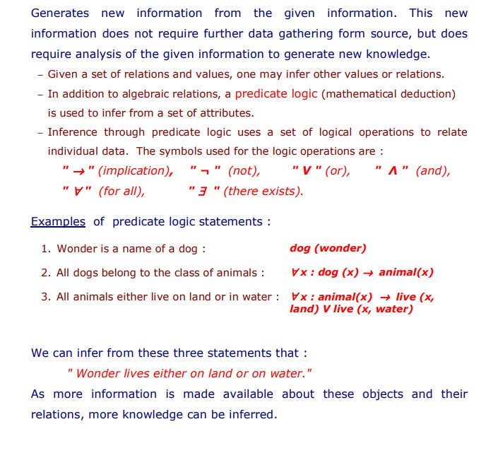
3.Inferential Knowledge

Slide 20
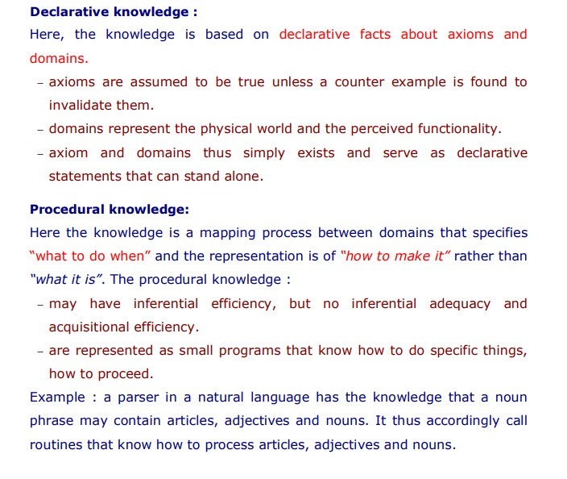
4.Declarative
/Procedural knowledge

Slide 21
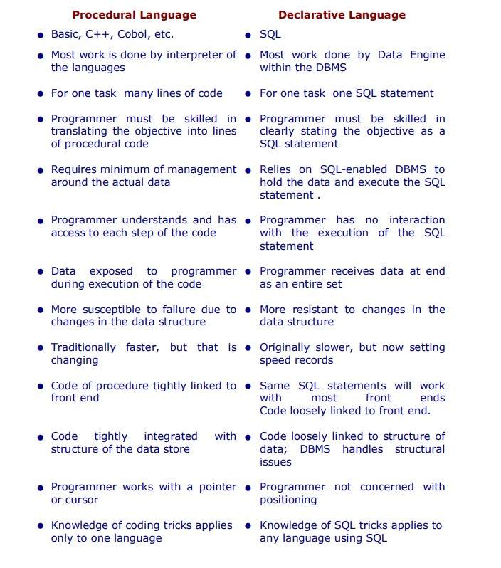

Slide 22
Issues in Knowledge Representation
The fundamental goal of Knowledge Representation is to facilitate inferencing (conclusions) from knowledge. The issues that arise while using KR techniques are many. Some of these are explained below.
Important Attributes : Any attribute of objects so basic that they occur in almost every problem domain ?
Relationship among attributes: Any important relationship that exists among object attributes ?
Choosing Granularity : At what level of detail should the knowledge be represented ?
Set of objects : How sets of objects be represented ?
Finding Right structure : Given a large amount of knowledge stored, how can relevant parts be accessed ?

Slide 23
Propositional Logic Predicate Logic

Slide 24
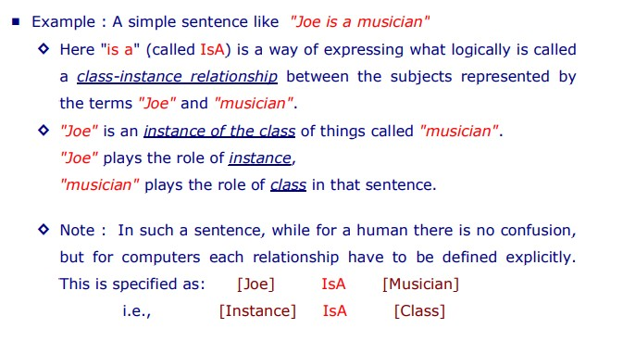
Representing “ IsA ” and “ Instance ” Relationships
Logic statements, containing subject, predicate, and object, were explained. Also stated, two important attributes "instance" and "isa", in a hierarchical structure (ref. fig. Inheritable KR). These two attributes support property inheritance and play important role in knowledge representation.

Slide 25
Computable Functions and Predicates?
The objective is to define class of functions C computable in terms of F. This is
expressed as C { F } is explained below using two examples :
"evaluate factorial n"
"expression for triangular functions".

Slide 26
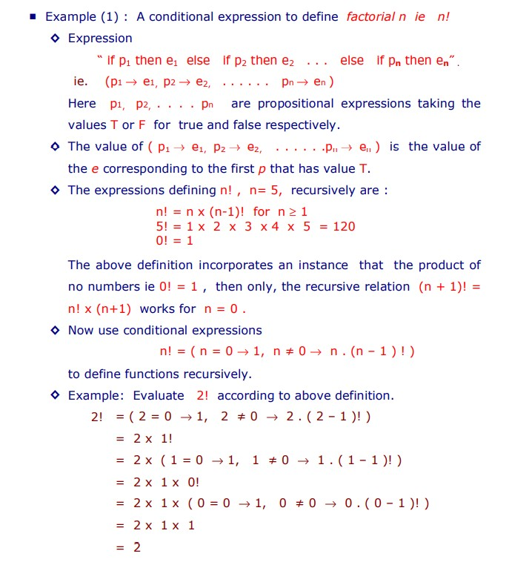
1.Evaluate Factorial

Slide 27
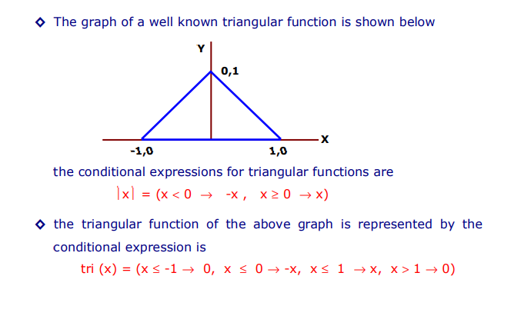
2.A
conditional expression for triangular functions

Slide 28
THANK YOU

